Slide 1
Microservices and Security
Parameswari Ettiappan

Slide 2
What is a Monolith Application?
Which is released (taken to production) once every few months
Which has a wide range of features and functionality
Which has a team of more than 50 working for it
Where debugging problems is a big challenge
Where bringing in new technology and new process is almost impossible
Monolith applications are typically huge - more 100,000 line of code. In some instances even more than million lines of code.

Slide 3
What is a Monolith Application?
Monoliths are characterized by
Large Application Size
Long Release Cycles
Large Teams

Slide 4
What is a Monolith Application?
Typical Challenges include
Scalability Challenges
New Technology Adoption
New Processes - Agile?
Difficult to Automation Test
Difficult ot Adapt to Modern Development Practices
Adapting to Device Explosion

Slide 5
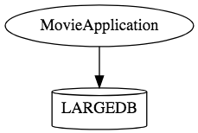
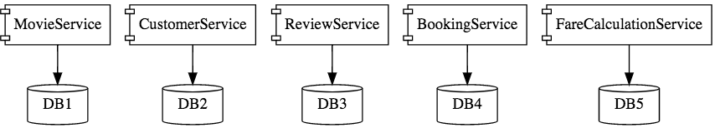
How does Microservice Architecture look like?

Slide 6
How does Microservice Architecture look like?

Slide 7
What is Microservices
Microservices is a variant of the service-oriented architecture (SOA) architectural style that structures an application as a collection of loosely coupled services.

Slide 8
What is Microservices
In a microservices architecture, services should be fine-grained and the protocols should be lightweight.
The benefit of decomposing an application into different smaller services is that it improves modularity and makes the application easier to understand, develop and test.

Slide 9
What is Microservices
It also parallelizes development by enabling small autonomous teams to develop, deploy and scale their respective services independently.

Slide 10
What are the Benefits of Microservices?
Smaller applications are not dependent on the same coding language, the developers can use the programming language that they are most familiar with.
That helps developers come up with a program faster with lower costs and fewer bugs.
The agility and low costs can also come from being able to reuse these smaller programs on other projects, making it more efficient.

Slide 11
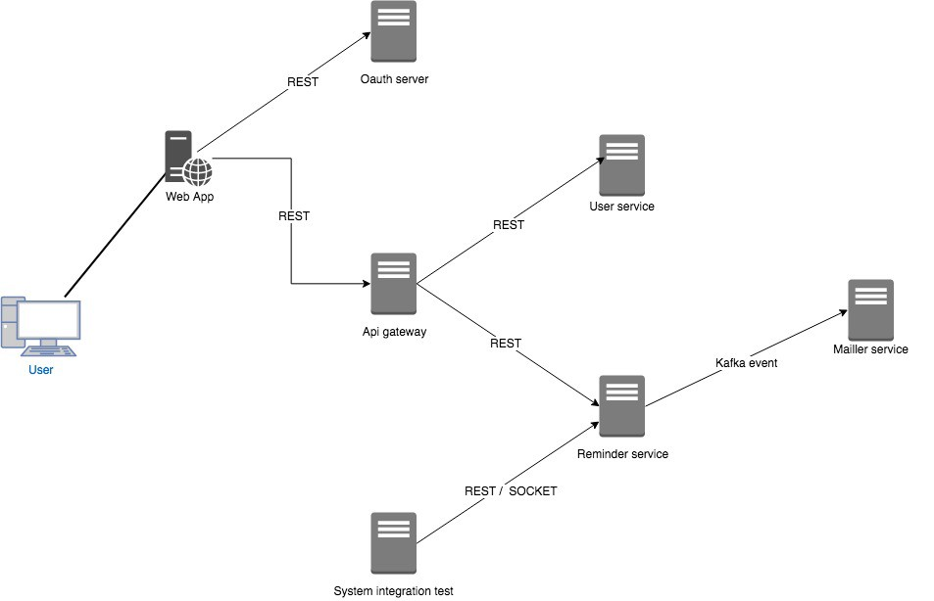

Slide 12
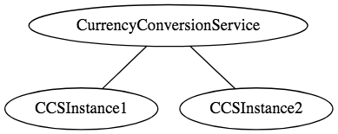
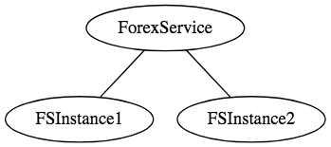
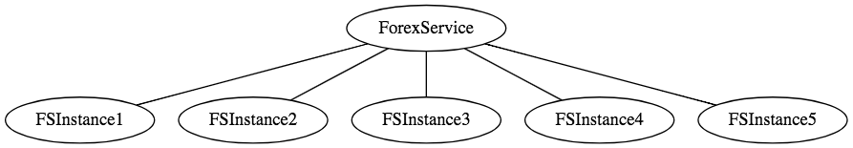
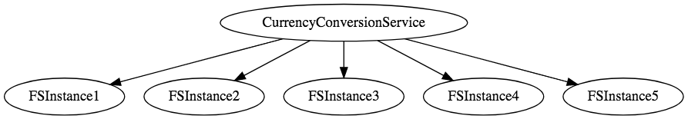

Slide 13
Examples of Microservices Frameworks for Java
There are several microservices frameworks that you can use for developing for Java. Some of these are:
Spring Boot. This is probably the best Java microservices framework that works on top of languages for Inversion of Control, Aspect Oriented Programming, and others.
Jersey. This open source framework supports JAX-RS APIs in Java is very easy to use.
Swagger. Helps you in documenting API as well as gives you a development portal, which allows users to test your APIs.

Slide 14
Challenges with Microservice Architectures
Quick Setup needed : You cannot spend a month setting up each microservice. You should be able to create microservices quickly.
Automation : Because there are a number of smaller components instead of a monolith, you need to automate everything - Builds, Deployment, Monitoring etc.
Visibility : You now have a number of smaller components to deploy and maintain. Maybe 100 or maybe 1000 components. You should be able to monitor and identify problems automatically. You need great visibility around all the components.

Slide 15
Challenges with Microservice Architectures
Bounded Context : Deciding the boundaries of a microservice is not an easy task. Bounded Contexts from Domain Driven Design is a good starting point. Your understanding of the domain evolves over a period of time. You need to ensure that the microservice boundaries evolve.
Configuration Management : You need to maintain configurations for hundreds of components across environments. You would need a Configuration Management solution
Dynamic Scale Up and Scale Down : The advantages of microservices will only be realized if your applications can scaled up and down easily in the cloud.
Pack of Cards : If a microservice at the bottom of the call chain fails, it can have knock on effects on all other microservices. Microservices should be fault tolerant by Design.

Slide 16
Challenges with Microservice Architectures
Debugging : When there is a problem that needs investigation, you might need to look into multiple services across different components. Centralized Logging and Dashboards are essential to make it easy to debug problems.
Consistency : You cannot have a wide range of tools solving the same problem. While it is important to foster innovation, it is also important to have some decentralized governance around the languages, platforms, technology and tools used for implementing/deploying/monitoring microservices.

Slide 17
Solutions to Challenges with Microservice Architectures
Spring Boot
Enable building production ready applications quickly
Provide non-functional features
embedded servers (easy deployment with containers)
metrics (monitoring)
health checks (monitoring)
externalized configuration

Slide 18
Solutions to Challenges with Microservice Architectures
Spring Cloud
Spring Cloud provides solutions to cloud enable your microservices. It leverages and builds on top of some of the Cloud solutions opensourced by Netflix (Netflix OSS).

Slide 19
Important Spring Cloud Modules
Dynamic Scale Up and Down. Using a combination of
Naming Server (Eureka)
Ribbon (Client Side Load Balancing)
Feign (Easier REST Clients)
Visibility and Monitoring with
Zipkin Distributed Tracing
Netflix API Gateway
Configuration Management with
Spring Cloud Config Server
Fault Tolerance with
Hystrix

Slide 20
Three Aspects of microservices

Slide 21
Technical

Slide 22
Architectural

Slide 23
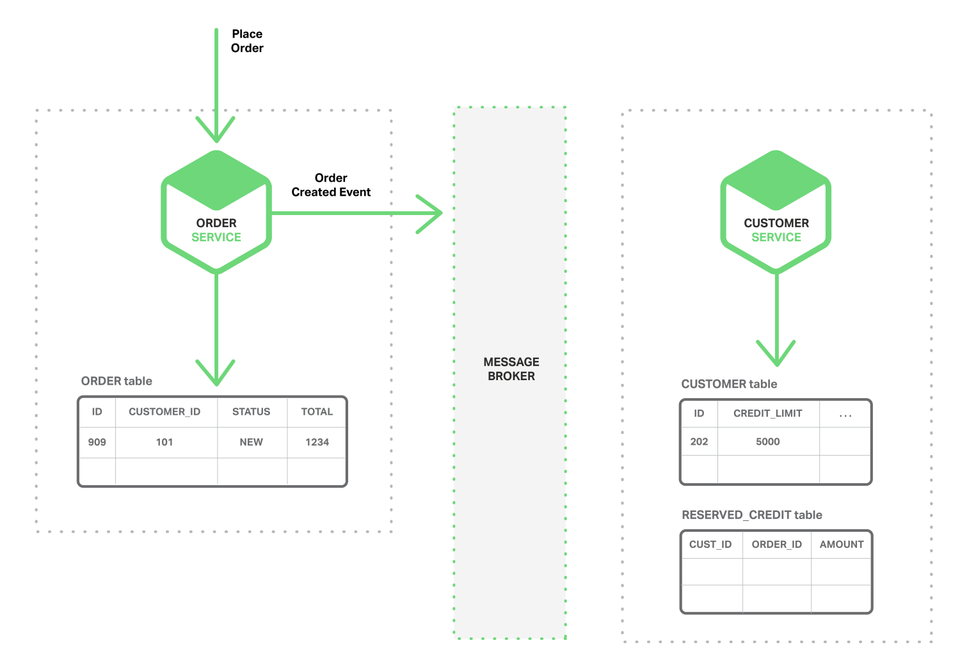

Slide 24
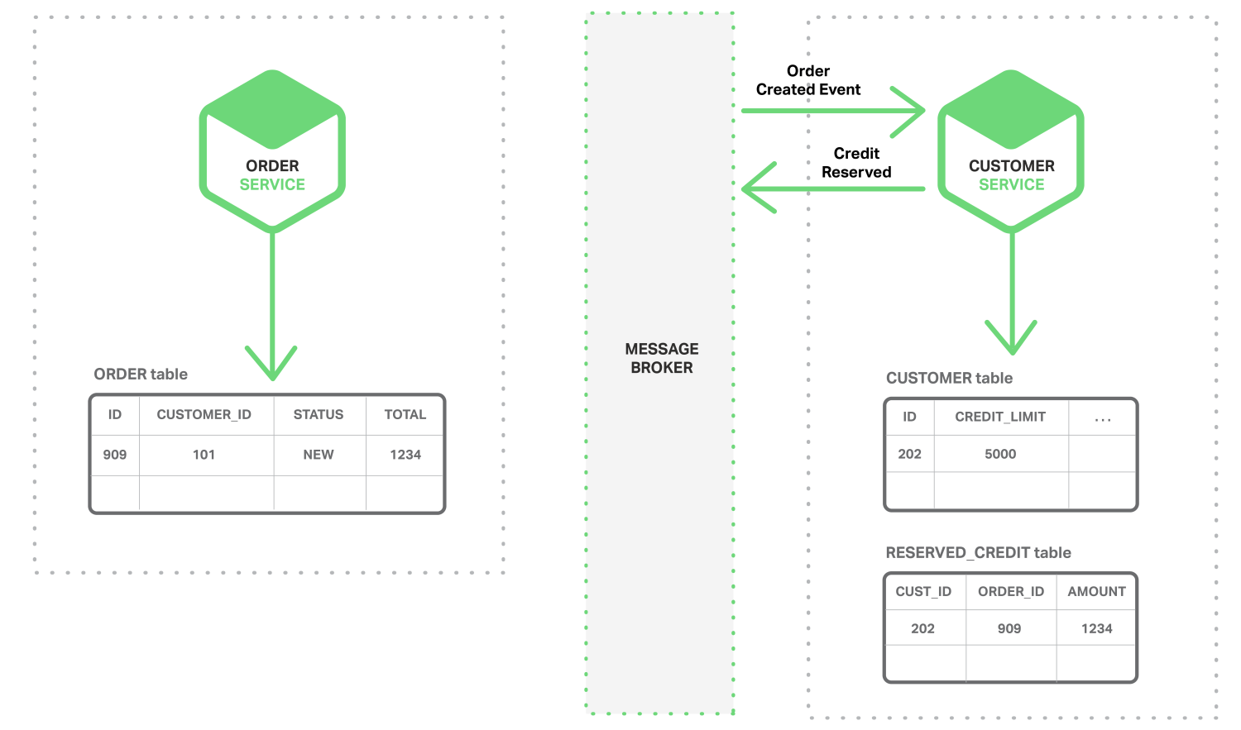

Slide 25
Organizational

Slide 26
Webservices

Slide 27
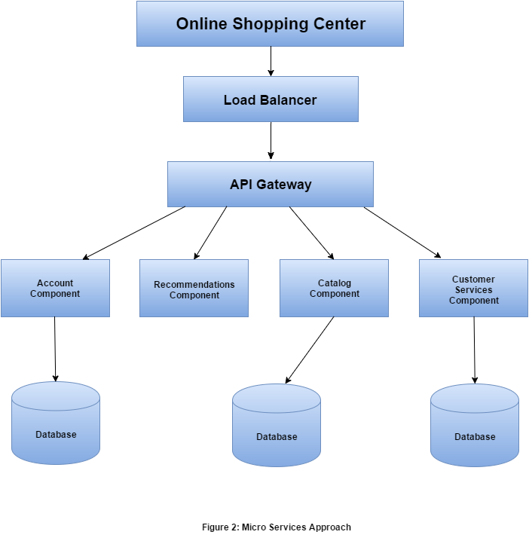
Microservices

Slide 28
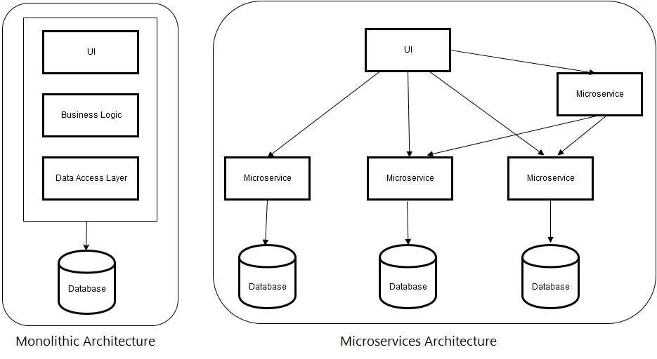

Slide 29
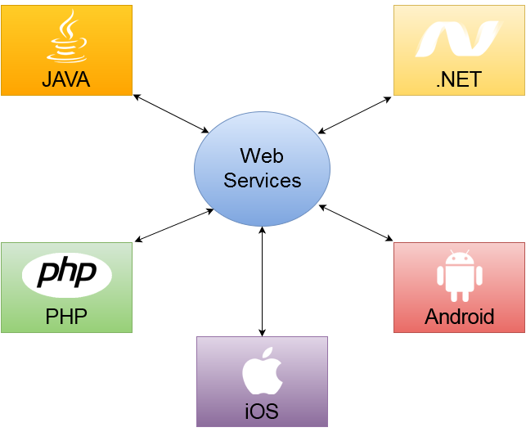

Slide 30
Patterns in Micro services Architecture
API Gateway
Service Registry
Service Discovery

Slide 31
Patterns in Micro services Architecture
API Gateway
Each micro service exposes a set of what are typically fine-grained end points

Slide 32
Patterns in Micro services Architecture
Service Registry
Helps to determine the location of service instances to send request to corresponding services
Netflix Eureka to register service

Slide 33
Patterns in Micro services Architecture
Service Discovery
In monolithic application, service call one another by remote procedure call.
Modern micro services run on VM where the number of instances and their locations change dynamically.
Each Service can be identified through router that are registered with service registry server

Slide 34
Micro services Architecture via Netflix Components
Operations Component | Spring, Netflix OSS
Service Discovery server | Netflix Eureka
Edge Server | Netflix Zuul
Central configuration server | Spring Cloud Config Server
Dynamic Routing and Load Balancer | Netflix Ribbon
OAuth 2.0 protected API’s | Spring Cloud + Spring Security OAuth2
Monitoring | Netflix Hystrix dashboard and turbine

Slide 35
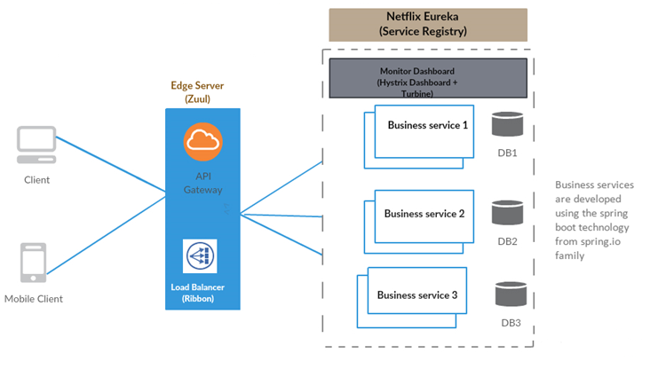

Slide 36
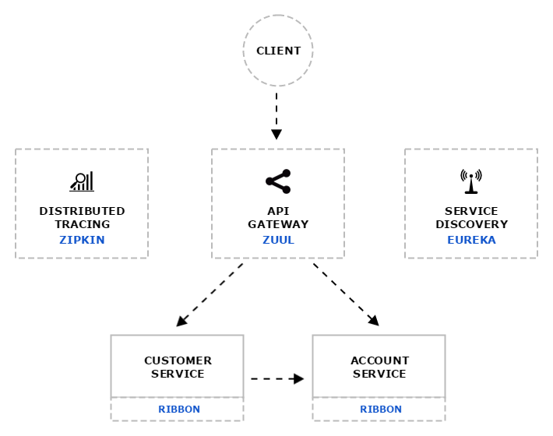
Distributed tracing system with request visualization.
Monitoring, routing and security
client side Load Balancers

Slide 37
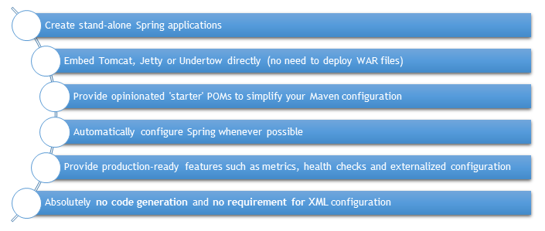
Spring Boot and Microservices

Slide 38
What is Zuul?
Zuul is the front door for all requests from devices and web sites to the backend of the Netflix streaming application.
As an edge service application, Zuul is built to enable dynamic routing, monitoring, resiliency and security.
It also has the ability to route requests to multiple Amazon Auto Scaling Groups as appropriate.

Slide 39
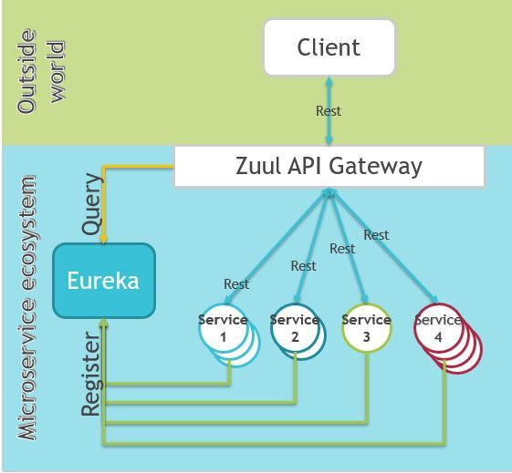
What is Zuul?

Slide 40
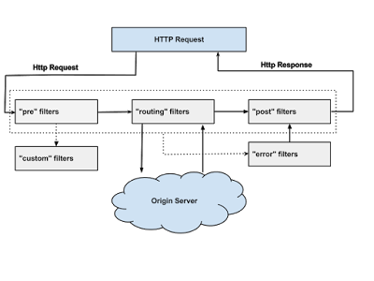

Slide 41
Why did we build Zuul?
The volume and diversity of Netflix API traffic sometimes results in production issues arising quickly and without warning.
We need a system that allows us to rapidly change behaviour in order to react to these situations.

Slide 42
Zuul Filetrs
Authentication and Security – identifying authentication requirements for each resource and rejecting requests that do not satisfy them.

Slide 43
Zuul Filetrs
Insights and Monitoring – tracking meaningful data and statistics at the edge in order to give us an accurate view of production.

Slide 44
Zuul Filetrs
Dynamic Routing – dynamically routing requests to different backend clusters as needed.

Slide 45
Zuul Filetrs
Stress Testing – gradually increasing the traffic to a cluster in order to gauge performance.

Slide 46
Zuul Filetrs
Load Shedding – allocating capacity for each type of request and dropping requests that go over the limit.

Slide 47
Zuul Filetrs
Static Response handling – building some responses directly at the edge instead of forwarding them to an internal cluster

Slide 48
Zuul Filetrs
Multiregion Resiliency – routing requests across AWS regions in order to diversify our Elastic Load Balancer usage and move our edge closer to our members

Slide 49
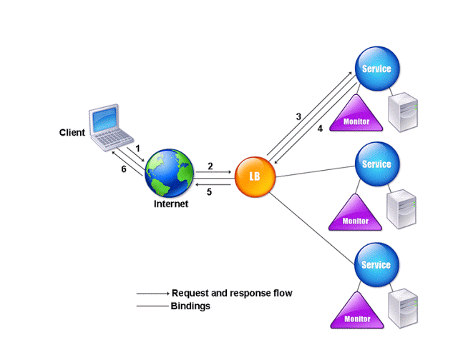
RIBBON LOAD BALANCER

Slide 50
RIBBON LOAD BALANCER
Ribbon is a client-side load balancer, which gives you a lot of control over the behavior of HTTP and TCP clients.
Ribbon's Client component offers a good set of configuration options such as connection timeouts, retries, retry algorithm (exponential, bounded back off) etc.
Ribbon comes built in with a pluggable and customizable Load Balancing component.

Slide 51
RIBBON LOAD BALANCER
Some of the load balancing strategies offered are listed below:
Simple Round Robin LB
Weighted Response Time LB
Zone Aware Round Robin LB
Random LB

Slide 52
RIBBON LOAD BALANCER
Ribbon provides the following features:
Load balancing
Fault tolerance
Multiple protocols (HTTP, TCP, UDP) support in an asynchronous and reactive model
Caching and batching

Slide 53
ELB
Elastic Load Balancing automatically distributes incoming application traffic across multiple Amazon EC2 instances.
It enables you to achieve fault tolerance in your applications, seamlessly providing the required amount of load balancing capacity needed to route application traffic.

Slide 54
ELB
Elastic Load Balancing offers two types of load balancers that both feature high availability, automatic scaling, and robust security.
Classic Load Balancer that routes traffic based on either application or network level information.
Application Load Balancer that routes traffic based on advanced application level information that includes the content of the request.

Slide 55
ELB
The Classic Load Balancer is ideal for simple load balancing of traffic across multiple EC2 instances, while the Application Load Balancer is ideal for applications needing advanced routing capabilities, microservices, and container-based architectures.
Application Load Balancer offers ability to route traffic to multiple services or load balance across multiple ports on the same EC2 instance.

Slide 56
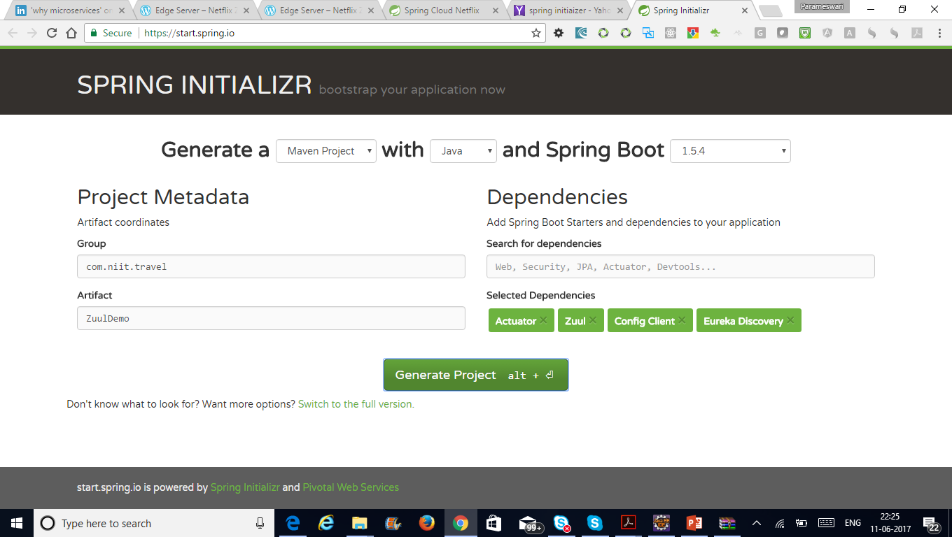

Slide 57

Docker
Docker is an open-source project that automates the deployment of applications inside software containers.
It is promoted by the company Docker, Inc.
Docker provides an additional layer of abstraction and automation of operating-system-level virtualization on Windows and Linux.

Slide 58
Docker vs VM
In a way, Docker is a bit like a virtual machine.
But unlike a virtual machine, rather than creating a whole virtual operating system, Docker allows applications to use the same Linux kernel as the system that they're running on
Only requires applications be shipped with things not already running on the host computer.
This gives a significant performance boost and reduces the size of the application.

Slide 59
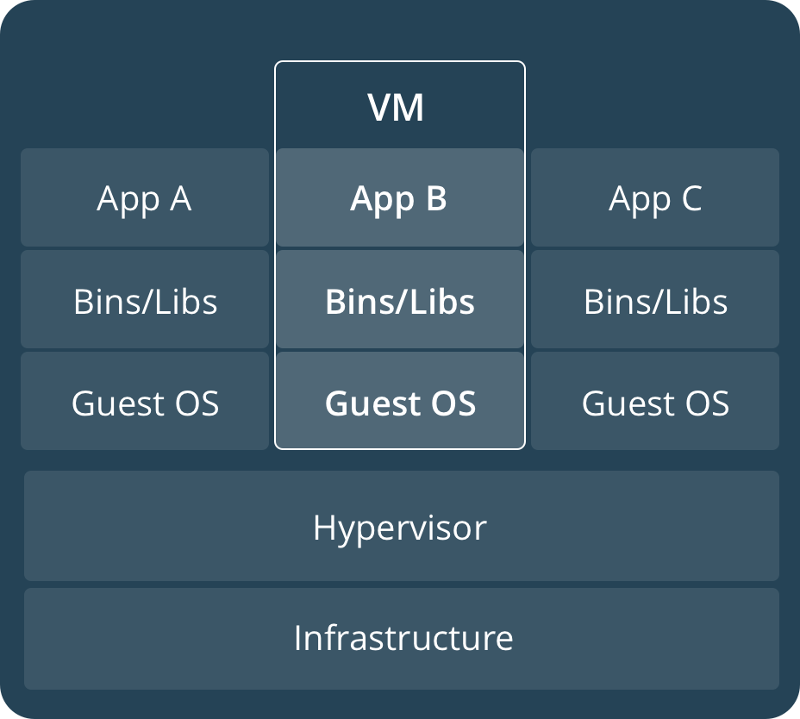
VM

Slide 60
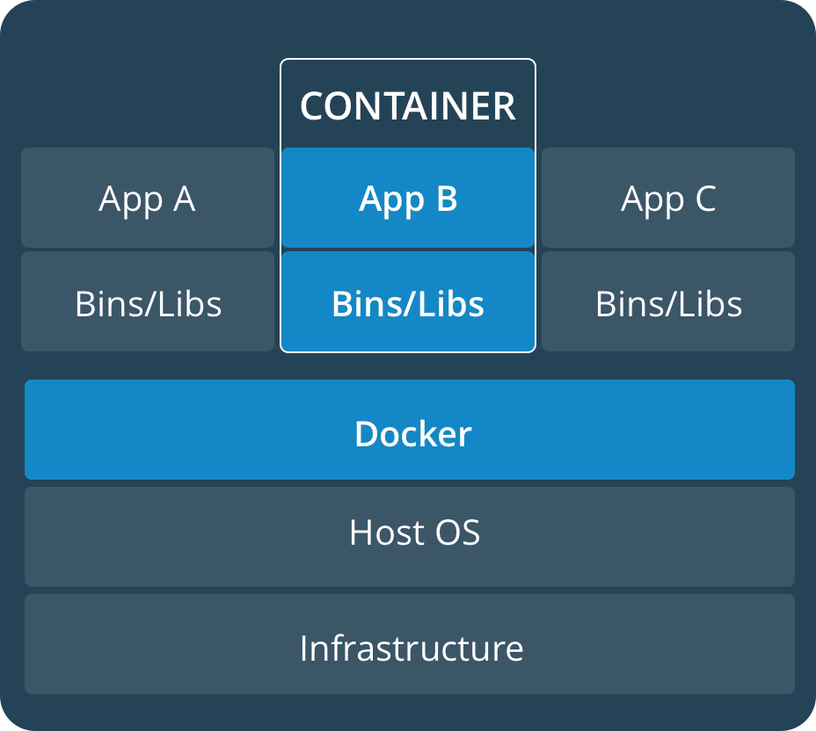
Container

Slide 61
Who is Docker for?
Docker is a tool that is designed to benefit both developers and system administrators, making it a part of many DevOps (developers + operations) toolchains.

Slide 62
Who is Docker for?
For developers, it means that they can focus on writing code without worrying about the system that it will ultimately be running on.
It also allows them to get a head start by using one of thousands of programs already designed to run in a Docker container as a part of their application.

Slide 63
Who is Docker for?
For operations staff, Docker gives flexibility and potentially reduces the number of systems needed because of its small footprint and lower overhead.

Slide 64
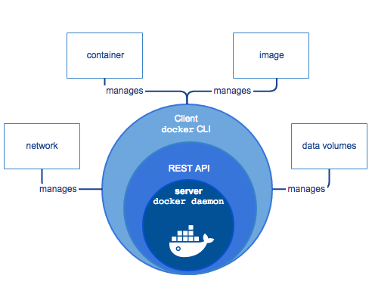

Slide 65
Docker Engine
Docker Engine is a client-server application with these major components:
A server which is a type of long-running program called a daemon process (the dockerdcommand).
A REST API which specifies interfaces that programs can use to talk to the daemon and instruct it what to do.
A command line interface (CLI) client (the docker command).

Slide 66
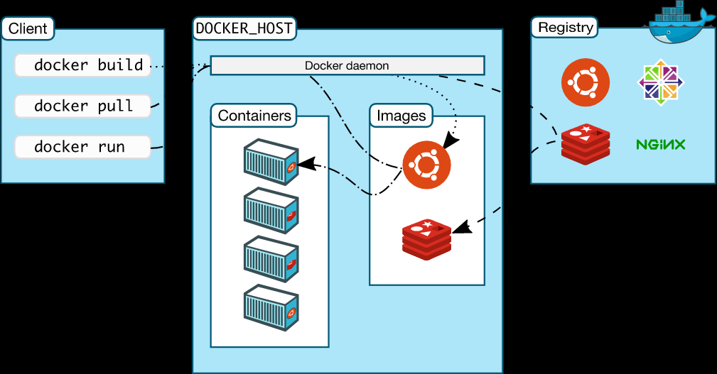
Docker architecture

Slide 67
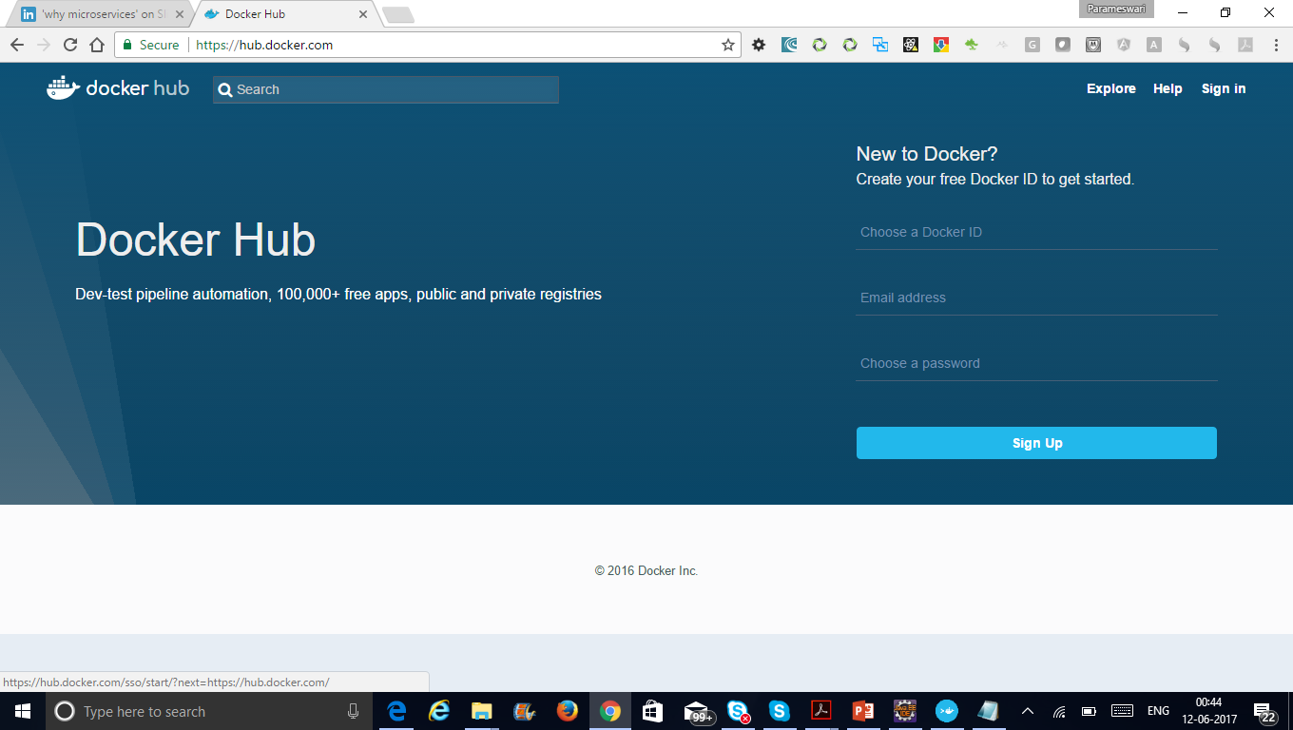
Docker Hub

Slide 68
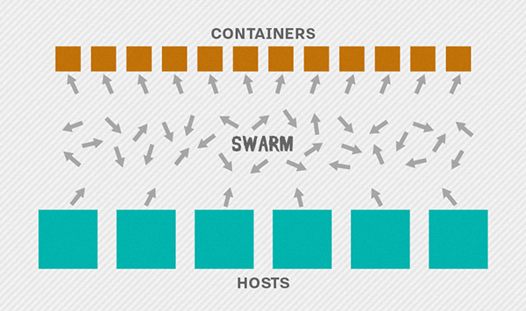
Docker Swarm

Slide 69
Docker Swarm
Cluster management integrated with Docker Engine
Decentralized design
Multi-host networking
Service discovery

Slide 70
Communication Patterns
API Gateway
Partial Failure
Circuit Breaker

Slide 71
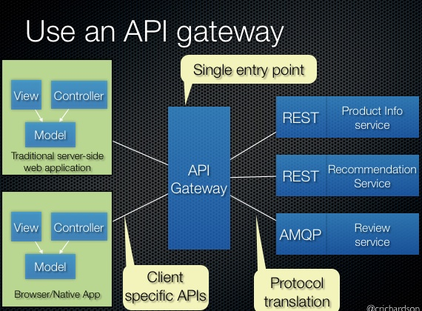
API Gateway

Slide 72
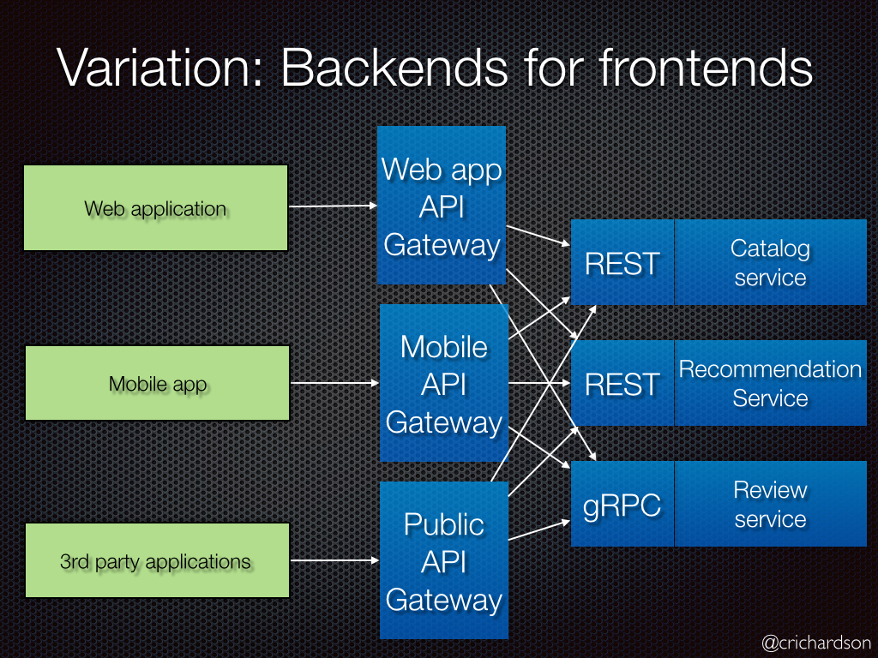
API Gateway

Slide 73
Circuit Breaker Pattern
Apply the Circuit Breaker pattern
Netflix’s Hystrix library provides an implementation of the Circuit Breaker pattern:
when we apply a circuit breaker to a method, Hystrix watches for failing calls to that method, and if failures build up to a threshold, Hystrix opens the circuit so that subsequent calls automatically fail.
While the circuit is open, Hystrix redirects calls to the method, and they’re passed on to our specified fallback method.

Slide 74
Event Driven Architecture

Slide 75
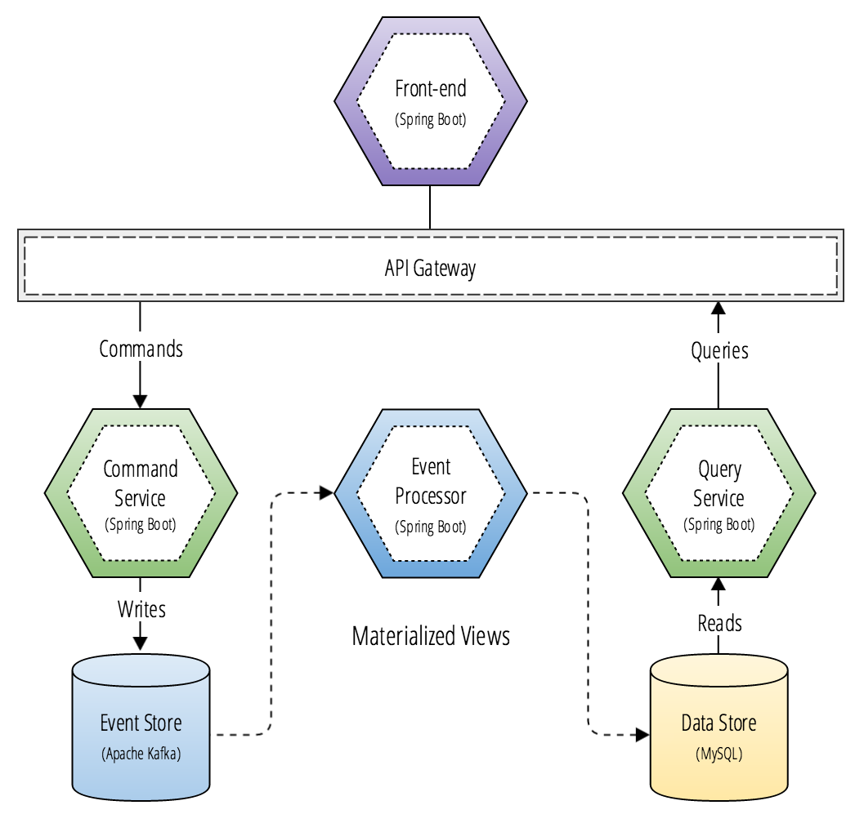
CQRS(Command Query Responsibility Segregation) and Micro services

Slide 76
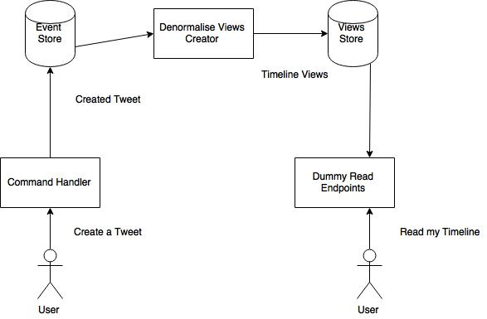
CQRS and Event Sourcing

Slide 77
Microservices Security
Kerckhoff’s Principle
Stated simply, the security of a cryptosystem should depend solely on the secrecy of the key. a cryptosystem should be secure even if everything about the system, except the key, is public knowledge.

Slide 78
Microservices Security
Claude Shannon Principle
The enemy knows the system.

Slide 79
Security through obscurity
An example of security by obscurity is when someone has an expensive house outfitted with the latest alarm system, but they keep the key and alarm code in the planter box next to the front door.
This is security by obscurity because if anyone knows the secret, i.e. that the key and code are stored in the planter, then the security of the entire system is compromised.

Slide 80
General Security Considerations
Are you just protecting your system at the Internet boundary?
What protections do you have in place if an intruder gets inside your core network?
How easily could someone inside your network get access to the traffic between your services?
Do your services trust each other too much?
When your service is called, does it require the calling software to authenticate itself, or does it let anything connect?

Slide 81
General Security Considerations
Do your services let their callers access all the APIs that a service offers, or just the ones it needs to fulfil its function?
Does the identity of the person who originated each call at the client get passed into your internal services, or is that lost at the gateway?
Can your services request any data from each other, or only the data of a user that has given their authority?

Slide 82
General Security Considerations
If an attacker owned a service, could they pretty easily request anything from its downstream services?
What guarantees do you have that a request received from an authenticated user hasn’t been tampered with? (Tamper-Proofing)
How do you ensure that an authorised request, delivered a second time, is detected and rejected? (Replay Protection)
Are you up to speed with the state of the art in password storage? (Password Storage)

Slide 83
General Security Considerations
Do you realise that, if your password database is stolen, simply salted hashes are completely useless these days? (Password Storage)
How do you actively identify the private and sensitive data in your database? (Promoting Privacy)
If your data gets stolen, what protections do you have in place to prevent the most sensitive parts from being readable? (Private & Sensitive Data)

Slide 84
General Security Considerations
If your services are using private keys, how do you protect those keys from being used by an intruder? (Key Management, Never assume that your secrets are safe)
Do you know what a Hardware Security Module (HSM) is, and when and how to make use of one?
What logging do you have in place that you can use to detect and analyse security breaches?

Slide 85
Middleware
Do you share a single database login across all your services?
How much data do your services have access to? All of it? Or only what they need? (Least Privilege)
Do your DB authorisation policies allow updates and deletes to tables that the application only ever inserts into?
Does your messaging middleware even have login credentials?
Do your services have access to all messages in your system, or only the ones they need to see?

Slide 86
Middleware
If an attacker got hold of one service’s messaging credentials, how much data could they get access to?
If an attacker got hold of one service’s messaging credentials, what operations could they initiate? (Least Privilege)
If you’re protecting your database and messaging with login credentials, how are you protecting the credentials? (Never assume that your secrets are safe)
How might the legacy systems in your architecture put other services at risk? (Securing the weakest link)

Slide 87
Edge Services
Have you upgraded your TLS implementations to the latest versions possible?
Have you configured TLS to eliminate downgrade and weak cipher attacks?
Who on your staff knows everything about TLS and how to configure it safely?
How do you ensure your internal websites and admin URLs aren’t accidentally opened up
I have a list of cracked passwords and user emails. Could I use your password reminder URL to test which users are in your system?

Slide 88
Edge Services
Does the rest of your system trust your gateway services too much? (Reluctance to Trust)
If you assume that your gateway services have been fully breached, what would you do differently elsewhere? (Defence in Depth)
If your gateway services were fully breached, what data could be gleaned from memory? (Defence in Depth)
If your gateway services were fully breached, what data could be captured from the network traffic? (Defence in Depth)

Slide 89
Web & Other Clients
How are you helping your users to choose safer passwords? (Password complexity)
When a password is entered wrong, what feedback do you give? Could it be used to enumerate user accounts? (Enumeration)
Do you lock an account after some number of failed login attempts? (Authentication)
How many chances do you give an attacker to guess the password on each account? (Account Security)
When you lock an account, what feedback do you give? Could it be used to enumerate user accounts? (Enumeration)

Slide 90
Web & Other Clients
How are you helping your users to choose safer passwords? (Password complexity)
When a password is entered wrong, what feedback do you give? Could it be used to enumerate user accounts? (Enumeration)
Do you lock an account after some number of failed login attempts? (Authentication)
How many chances do you give an attacker to guess the password on each account? (Account Security)
When you lock an account, what feedback do you give? Could it be used to enumerate user accounts? (Enumeration)

Slide 91
Web & Other Clients
Has anyone else noticed there seems to be an epic battle between security and good User Experience? (UX vs Security)
Are you familiar with the OWASP Top Ten web vulnerabilities? (Web Security Flaws)
Could you name all of the OWASP Top Ten web vulnerabilities? (Web Security Flaws)
Could everyone on your team name all of the OWASP Top Ten? (Web Security Flaws)
Could everyone on your team explain how to protect against all of the OWASP Top Ten? (Web Security Flaws)
How do you ensure that every piece of user data is properly escaped when used as output? (XSS / Output Encoding)

Slide 92
Web & Other Clients
How are you helping prevent your users from getting attacked as a result of using your web app?
Does your web app design treat the browser as an insecure environment? (Reluctance to Trust)
Does your native mobile app design treat the device as an insecure environment? (Reluctance to Trust)
How are you helping prevent your users from getting attacked as a result of using your native app?
What data are you storing or caching on the client? How are you protecting it? What could happen if someone stole it? Does it need to be there at all?

Slide 93
People & Process
What are you doing to ensure security is baked into everything your engineering team does? (Build Security In)
How do you burn common security principles into everyone’s brains? (Security Principles)
What security activities are explicitly built into your development process? (Secure Software Development Process)
What security training do you provide for your developers, testers and operations staff? (Security Training)
Do tech staff just know the names of vulnerabilities, or do they actually know how to exploit & test them? (Security Training)
What controls have you put around who can access which parts of your system? (Access Control)

Slide 94
People & Process
What’s your plan for regularly reviewing the appropriateness of those controls and people’s access? (Access Control Review/Audit)
What’s your process for discovering and remediating vulnerabilities in 3rd party software? (Vulnerability Management)
How do you encourage engineers to dedicate time to brainstorming the risks in your systems? (Risk Brainstorming / “Risk-storming”)
Do you have service templates that ensure every new service starts off with great security? (Secure Application Templates)
What’s your plan for getting internal staff regularly testing the security of your systems? (Security Testing)
What’s your plan for how often you’ll bring in external security experts, and how you’ll choose what they focus on? (Security Testing)

Slide 95
People & Process
What activities do you get expert help with? Just penetration testing? How about design and architecture reviews? (Security Testing)
What automated tests do you have to catch vulnerabilities as they’re written? (Automated Security Testing)
What automated tests do you have to ensure security controls are always in place? (Automated Security Testing)
Are you constantly asking yourselves: “What if this control fails? What’s the next control?” (Defence in Depth)

Slide 96
Security Best Practices
1. Use OAuth for user identity and access control
Use 'defence in depth' to prioritize key services
Don’t write your own crypto code
use NaCl/libsodium for encryption
Use automatic security updates
Use a distributed firewall with centralized control
Get your containers out of the public network
Monitor everything with a tool

Slide 97
Security Best Practices
Built originally by engineers at SoundCloud, Prometheus is an open source monitoring platform and a part of the Cloud Native Computing Foundation.

Slide 98
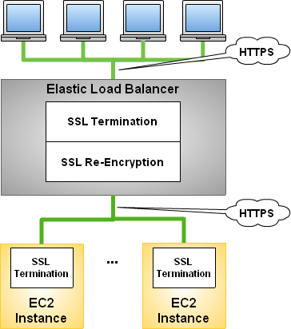
Securing Your Microservices via Bi-Directional TLS

Slide 99
JSON Web Token (JWT)
JSON Web Token or JWT is one of the popular token format used for web applications and web service APIs for authentication nowadays.
It is a open standard defined in RFC 7519 .

Slide 100
Structure of JWT
Basically the token has three parts separated by dots(.), following are the denotes the parts:
Header
Payload
Signature

Slide 101
Header
{
"alg": "HS256",
"typ": "JWT"
}
The Base64 encoded string of the above header JSON is :
eyJhbGciOiJIUzI1NiIsInR5cCI6IkpXVCJ9

Slide 102
Payload
Registered Claims
Public Claims
Private Claims

Slide 103
Registered Claims
exp: Expiration Value(Type: Number – DateTime). This is commonly used one by the most of the issuer. It has a numeric value that denotes a time interval. The token will expire after this time interval from the current time.
iss: Issuer (Type: String or URI)
sub: Subject (Type: String)
aud: Audience (Type: String or URI)
nbf: Not Before (Type: Number – DateTime). Denotes the numeric value of time before which the token must not be accept for processing.
iat: Issued At (Type: Number – DateTime). It denotes the numeric format of issued data and time.
jti: JWT ID (Type: String). It is the unique identifier for the JWT token.

Slide 104
Public Claims
The user defined data fields carry application related informations like name. These type of fields are called public claims.

Slide 105
Private Claims
We can also use our custom fields in the payload.
The fields added by user for improving information interchange is called the Private Claims.
The parties should agree for using them.

Slide 106
Signature
The final part of the JWT is the signature.
It is created by hashing the Header, Payload and secret. If our secret is secret then the signature is a hash of the concatenated base64 encoded header and payload with dot (.):
Usually the server will give the JWT token to corresponding client application after a successful authentication. Preparing of the JWT token could be done by server application. The method hashUsingSHA256 encode the concatinatedString with the secret key in the server side.

